Slide 1
Z02DT - Software and Databases
Entity Relationship Diagram (ERD)

Slide 2

Lesson aim
Database Design Concepts

Slide 3
By the end of this session you will be able to - Design Entity Relationship Diagrams (ERD) for CW2 - Resolve M:M relationship - Understand primary and foreign keys - Draw Conceptual, Logical and Physical diagrams for your project
Lesson objectives

Slide 4
Designing Relational Database
Entity:
Is something to keep information about
It is an individual object (a person, a place, a thing, a concept or an event)
Entity forms a table in a relational database

Slide 5

Designing Relational Database
Entity:
You can start to design your CW2 artefact now
What Entities might you use for your school DB?
STUDENT
COURSE
ENROLMENT

Slide 6
Designing Relational Database
Attribute:
Is a characteristic or property of an entity
Attributes become fields (columns) in a relational database

Slide 7
Designing Relational Database
Attribute:
What attributes might you require for the Student entity?
Name
Address
Telephone
Medical details

Slide 8
Designing Relational Database
Relationship:
Is an association between two entities
It links two tables in a Relational Database
Relationships can be
one to one (1:1)
one to many (1:M)
many to many (M:M)

Slide 9
Entity Relationship Diagram (ERD)
Contains entities and the relationships between entities
Entity
one to one relationship (1:1)
one to many relationship (1:M)
many to many relationship (M:M)

Slide 10
Examples of 1:1 Relationships
PILOT
flies
AIRCRAFT
is flown by
PATIENT
occupies
BED
is occupied by
CUSTOMER
makes
RESERVATION
is made by

Slide 11
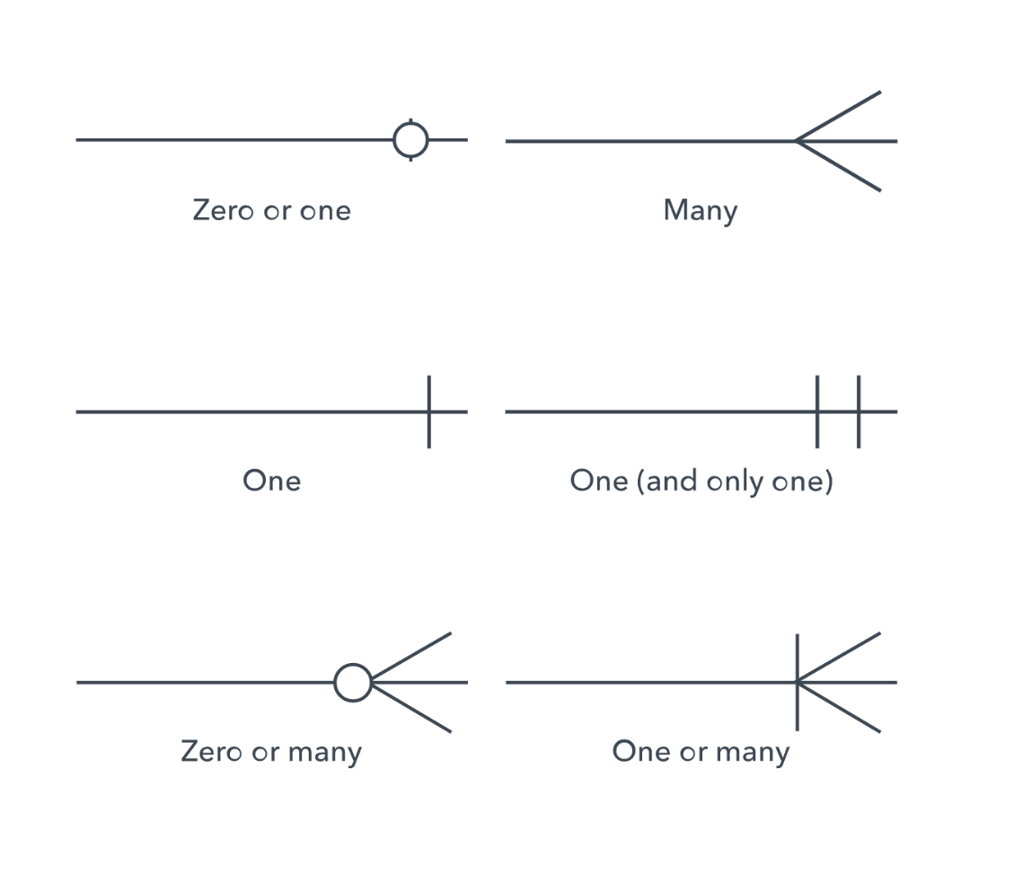
Cardinality
Defines the numerical attributes of the relationship between two entities or entity sets.
The three main cardinal relationships are one-to-one, one-to-many, and many-many

Slide 12
Summary
Let’s watch this video
https://www.youtube.com/watch?v=QpdhBUYk7Kk&t=1s

Slide 13
M:M Relationships
Many to many relationships are difficult to represent and use in database designs
We need to remove these from our models
Student
Module

Slide 14
M:M Relationship Decomposition Rule
Entity Relationship Modelling

Slide 15
Removing M:M Relationships
We can split a many to many relationship into two one to many relationships
An entity represents the M:M relationship
Student
Student
Has
Enrolment
In
Module
Module

Slide 16
Primary key
Primary Key is an attribute of an entity which identifies each record uniquely
Must be:
Unique
Consistent
Meaningful

Slide 17
Primary key
What unique attribute could you use as the Primary key for the STUDENT entity?

Slide 18
Primary key
What unique attribute could you use as the Primary key for the STUDENT entity?
StudentID
STUDENT (StudentID , Name , …)

Slide 19
Foreign key
A Foreign Key is the primary key of another table used to create link between two tables
Example:
STUDENT(StudentID, CourseID, Student Name, …)
COURSE (CourseID, Course Name, …)
CourseID is the identifier (primary key) of the COURSE table.
The CourseID is posted into the student table and is thus called a FOREIGN KEY
Now for any student we can easily find the appropriate CourseID and look up further details of that course in the COURSE table if needed.
This is easy to do in any relational database

Slide 20
Example
A university consists of a number of departments.
Each department offers several courses.
A number of modules make up each course.
Students enrol in a particular course and take modules towards the completion of that course.
Each module is taught by a lecturer from the appropriate department, and each lecturer tutors a group of students.

Slide 21
Example - Entities
A university consists of a number of departments.
Each department offers several courses.
A number of modules make up each course.
Students enrol in a particular course and take modules towards the completion of that course.
Each module is taught by a lecturer from the appropriate department, and each lecturer tutors a group of students.
Exercise:
Identify the Entities in the above requirement specification

Slide 22
Example - Entities
A university consists of a number of departments.
Each department offers several courses.
A number of modules make up each course.
Students enrol in a particular course and take modules towards the completion of that course.
Each module is taught by a lecturer from the appropriate department, and each lecturer tutors a group of students

Slide 23
Example - Entities
Exercise:
Consider your Assignment Brief
What Entities can you identify?

Slide 24
Example - Relationships
A university consists of a number of departments.
Each department offers several courses.
A number of modules make up each course.
Students enrol in a particular course and take modules towards the completion of that course.
Each module is taught by a lecturer from the appropriate department, and each lecturer tutors a group of students.
Exercise:
Identify the Relationships in the above requirement specification

Slide 25
Example - Relationships
A university consists of a number of departments.
Each department offers several courses.
A number of modules make up each course.
Students enrol in a particular course and take modules towards the completion of that course.
Each module is taught by a lecturer from the appropriate department, and each lecturer tutors a group of students.

Slide 26
Example - Relationships
Exercise:
Consider your Assignment Brief
What Relationships can you identify?

Slide 27
Example – Entity Relationship Diagram
Entities: Department, Course, Module, Lecturer, Student
Department
Course
Module
Lecturer
Student

Slide 28
Example – Entity Relationship Diagram
Each department offers several courses
Offers
Department
Course
Module
Lecturer
Student

Slide 29
Example – Entity Relationship Diagram
A number of modules make up each courses
Offers
Department
Course
Includes
Module
Lecturer
Student

Slide 30
Example – Entity Relationship Diagram
Students enrol in a particular course
Offers
Department
Course
Includes
Module
Lecturer
Enrols In
Student

Slide 31
Example – Entity Relationship Diagram
Students … take modules
Offers
Department
Course
Includes
Module
Lecturer
Takes
Enrols In
Student

Slide 32
Example – Entity Relationship Diagram
Each module is taught by a lecturer
Offers
Department
Course
Includes
Module
Teaches
Lecturer
Takes
Enrols In
Student

Slide 33
Example – Entity Relationship Diagram
a lecturer from the appropriate department
Offers
Department
Employs
Course
Includes
Module
Teaches
Lecturer
Takes
Enrols In
Student

Slide 34
Example – Entity Relationship Diagram
each lecturer tutors a group of students
Offers
Department
Employs
Course
Includes
Module
Teaches
Lecturer
Takes
Enrols In
Student
Tutors

Slide 35
Example – Entity Relationship Diagram
Offers
Department
Employs
Course
Includes
Module
Teaches
Lecturer
Takes
Enrols In
Student
Tutors

Slide 36
Group Activity (15 Minutes)
“A database will be made to store information about patients in a hospital.
On arrival, each patient’s personal details (name, address, and telephone number) are recorded where possible, and they are given an admission number.
They are then assigned to a particular ward (Accident and Emergency, Cardiology, Oncology, etc.).
In each ward there are a number of doctors and nurses.
A patient will be treated by one doctor and several nurses over the course of their stay, and each doctor and nurse may be involved with several patients at any given time.”
Task
Identify the entities, attributes, relationships, and cardinality ratios from the description.

Slide 37
ERD – Conceptual Model
The conceptual model is the starting point of a database design
The Entities are identified and the relationships between them
We do not consider any fields / Attributes at this stage

Slide 38
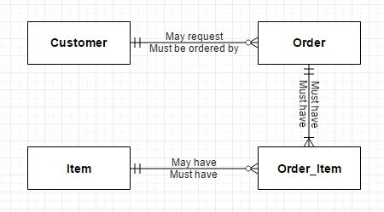
ERD - Conceptual Model
ERD – Conceptual Model

Slide 39
ERD - Logical Model
The Logical Model is where we bring in the attributes and consider how the relationships required in the Conceptual Model will be implemented.
We should consider which attributes are required and which are Primary and Foreign Keys

Slide 40
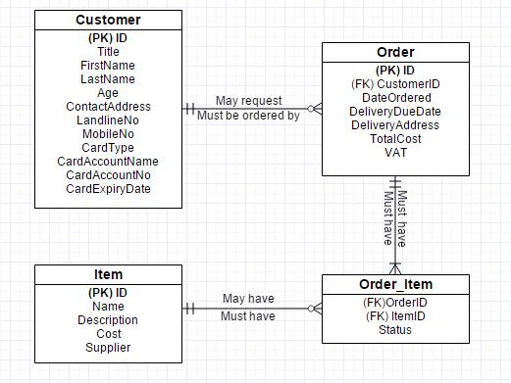
ERD - Logical Model

Slide 41
ERD - Physical Model
The Physical Model describes how the database will be physically implemented
It contains the specification for each field/attribute and what type and size of data it will actually hold
The database can be implemented from the Physical Model as it contains all of the necessary specifications

Slide 42
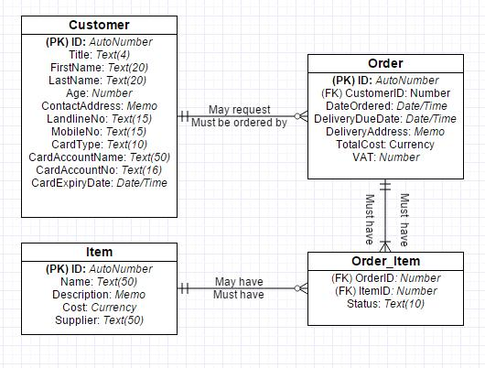
ERD - Physical Model

Slide 43
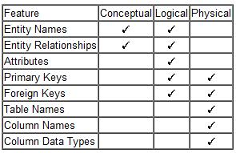
ERD - Summary
ERD - Summary

Slide 44
ER Diagram
Student Activity:
Identify the entities, attributes, relationships, and cardinality ratios from the description given in your coursework.
Draw an entity-relationship diagram showing the items you identified.

